Slide 1
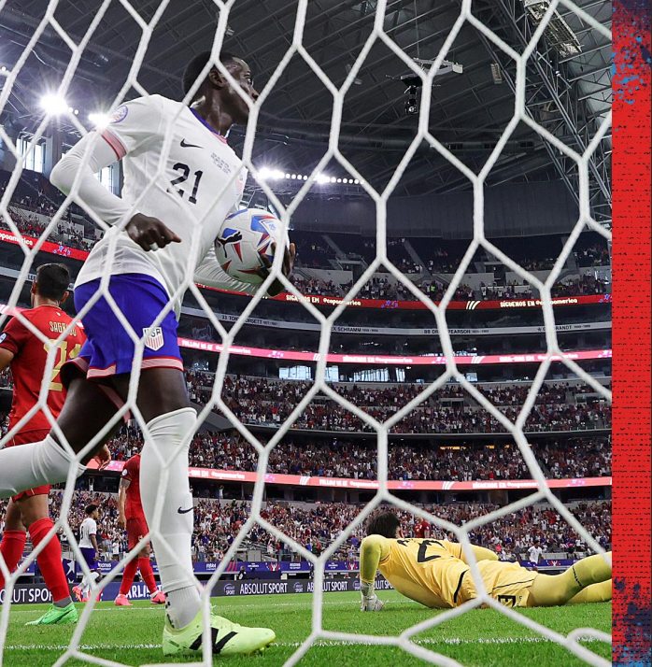




Slide 2

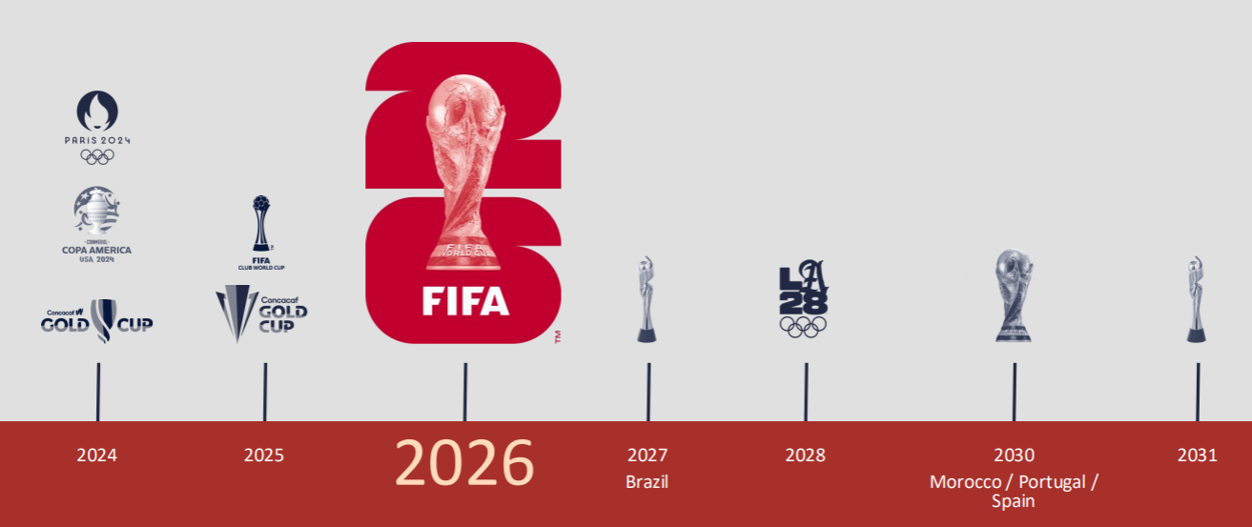


THE MOMENT IS NOW
IN THE SUMMER OF 2026, THE U.S. WILL HOST THE MOST-WATCHED SPORTING EVENT IN THE WORLD
global viewership figures are projected. Source: FIFA 2024

Slide 3
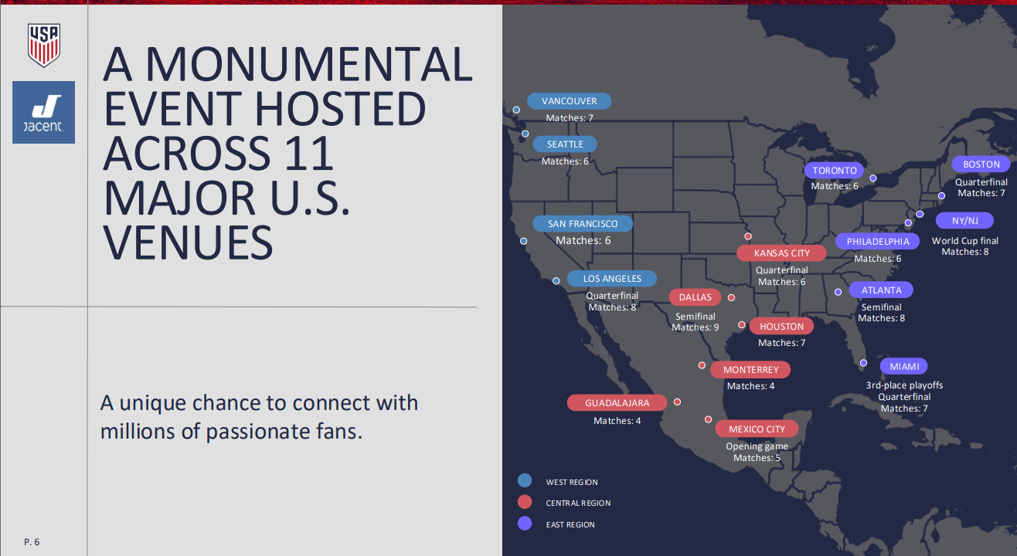

Slide 4
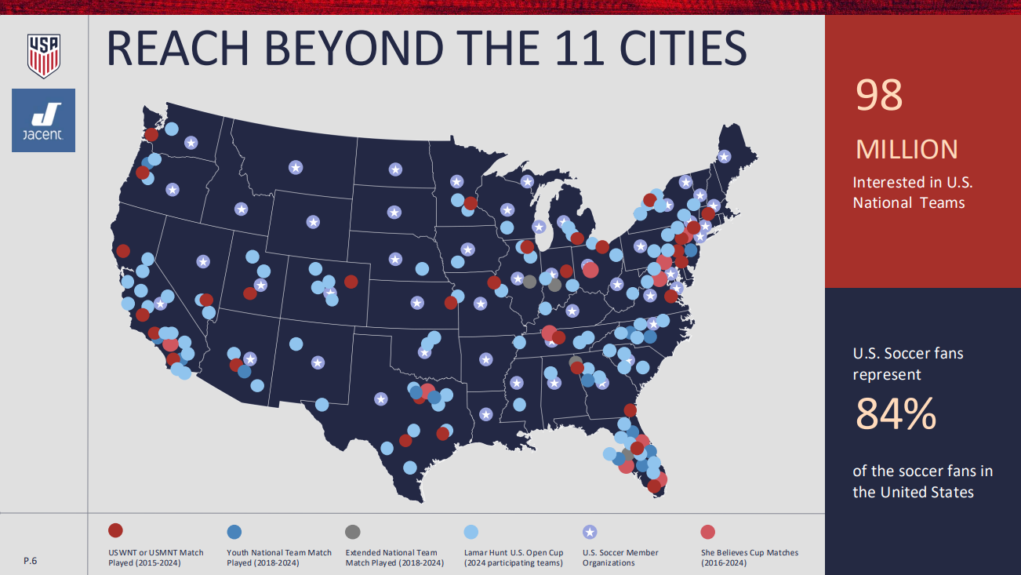

Slide 5

X

Slide 6
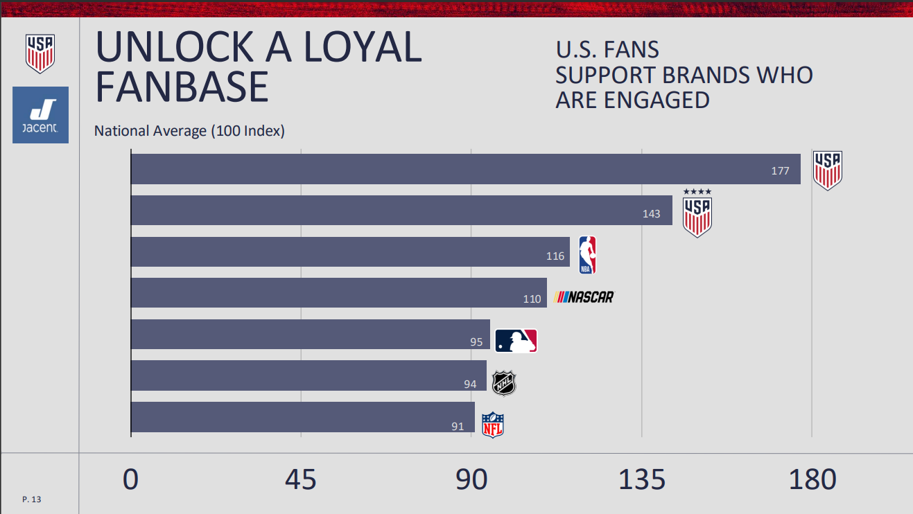

Slide 7
Dates: June 11th – July 19th
Host Cities & Key Matches
United States (11 host cities)
Atlanta, Georgia – Mercedes‑Benz Stadium (~71,000)
Boston, Massachusetts – Gillette Stadium (~66,000)
Dallas, Texas – AT&T Stadium (~80,000)
Houston, Texas – NRG Stadium (~71,500)
Kansas City, Missouri – Arrowhead Stadium (~76,400)
Los Angeles, California – SoFi Stadium (~70,000)
Miami, Florida – Hard Rock Stadium (~65,300)
New York / New Jersey – MetLife Stadium (~82,500), *final on July 19, 2026*
Philadelphia, Pennsylvania – Lincoln Financial Field (~69,000)
San Francisco Bay Area, California – Levi’s Stadium (~68,500)
Seattle, Washington – Lumen Field (~69,000)
Opening Match: June 11, 2026, at Estadio Azteca, Mexico City
First Match in Canada: June 12, 2026, at BMO Field, Toronto
First Match in the USA: June 12, 2026, at SoFi Stadium, Los Angeles
Semi-Finals: AT&T Stadium (Dallas) and Mercedes-Benz Stadium (Atlanta)
Final Match: July 19, 2026, at MetLife Stadium, East Rutherford, New Jersey
Third-Place Playoff: Hard Rock Stadium (Miami)
US SOCCER 2026

Slide 8
Top 25 Cities – Outside of Host Cities
High US Soccer Engagement
Dates: June 11th – July 19th
New York-Newark-Jersey City, NY-NJ
Austin-Round Rock-San Marcos, TX
Cincinnati, OH-KY-IN
Washington-Arlington-Alexandria, DC-VA-MD-WV
Los Angeles-Long Beach-Anaheim, CA
Boston-Cambridge-Newton, MA-NH
San Francisco-Oakland-Fremont, CA
Dallas-Fort Worth-Arlington, TX
Des Moines-West Des Moines, IA
Denver-Aurora-Centennial, CO
Sacramento-Roseville-Folsom, CA
Hartford-West Hartford-East Hartford, CT
San Diego-Chula Vista-Carlsbad, CA
Logan, UT-ID
Seattle-Tacoma-Bellevue, WA
Columbus, OH
Chicago-Naperville-Elgin, IL-IN
Minneapolis-St. Paul-Bloomington, MN-WI
Atlanta-Sandy Springs-Roswell, GA
Heber, UT
Ogden, UT
Philadelphia-Camden-Wilmington, PA-NJ-DE-MD
Provo-Orem-Lehi, UT
Madison, WI
Worcester, MA
US SOCCER 2026

Slide 9
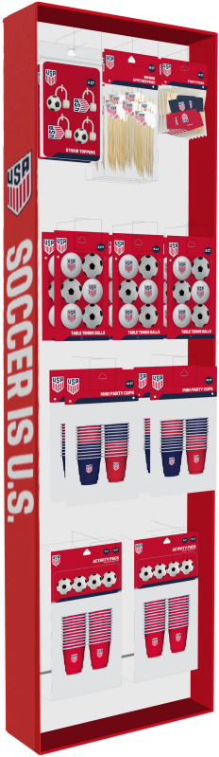
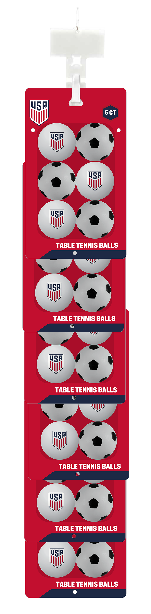
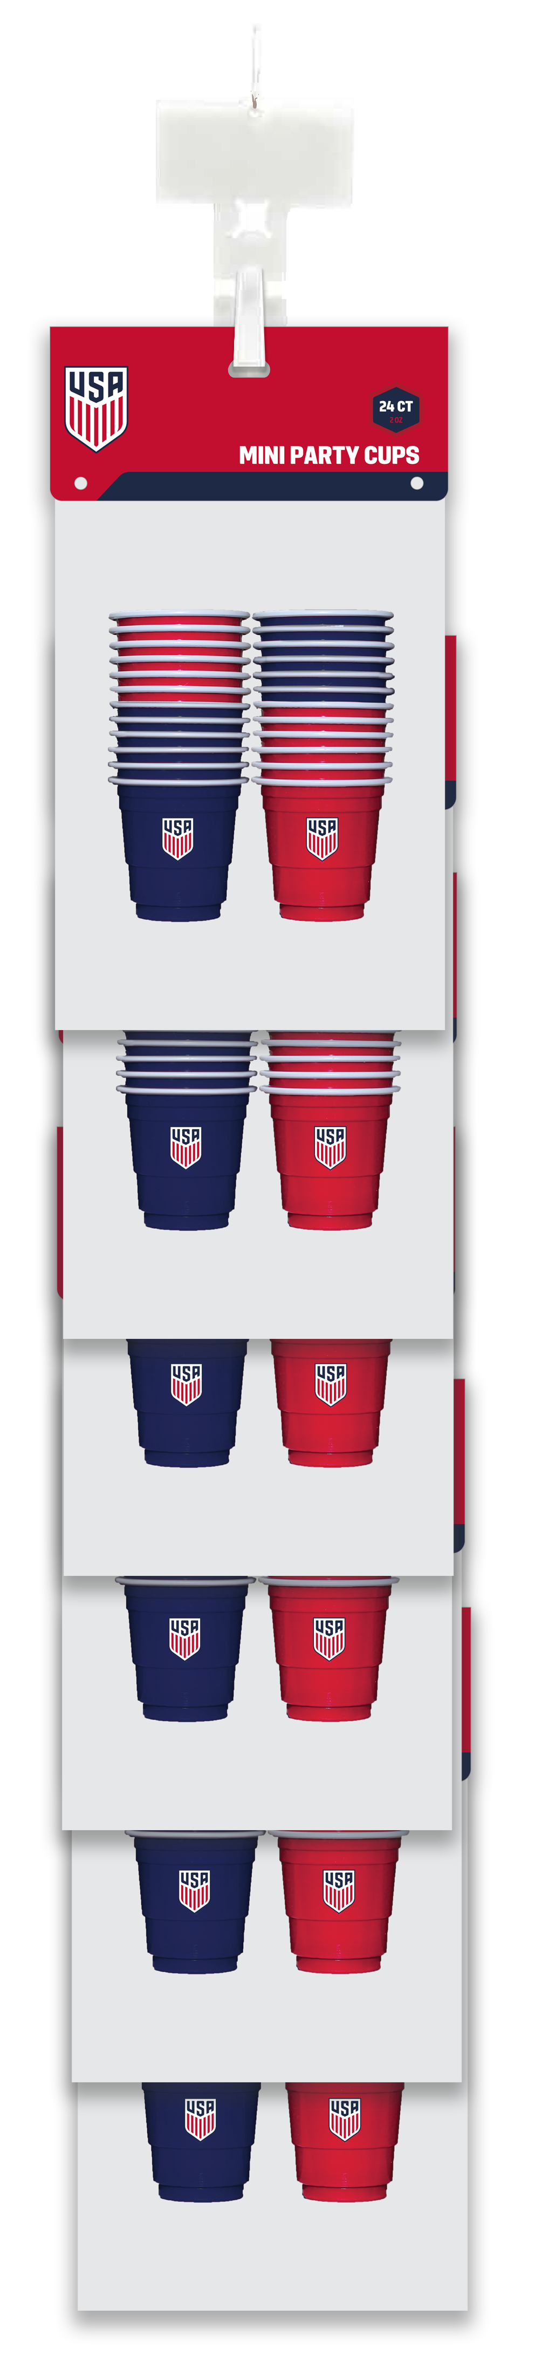
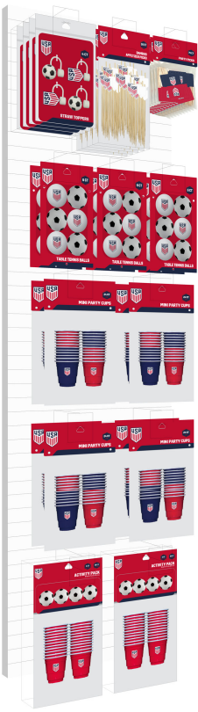
Many Display Options. Massive Sales Wins.
FLOOR DISPLAY
FLEXCLIP
POWER PANEL

Slide 10

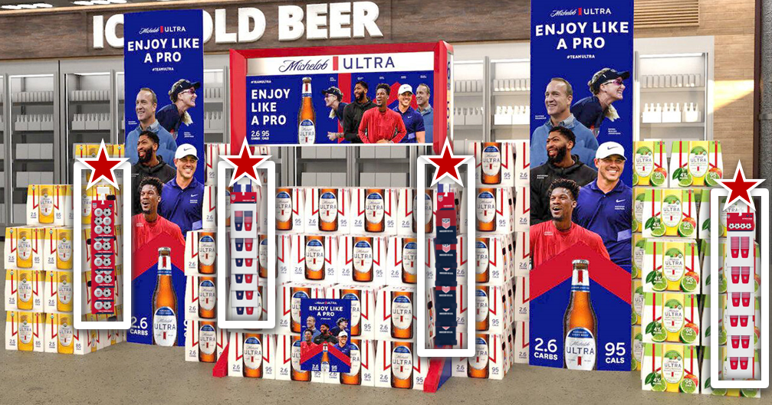
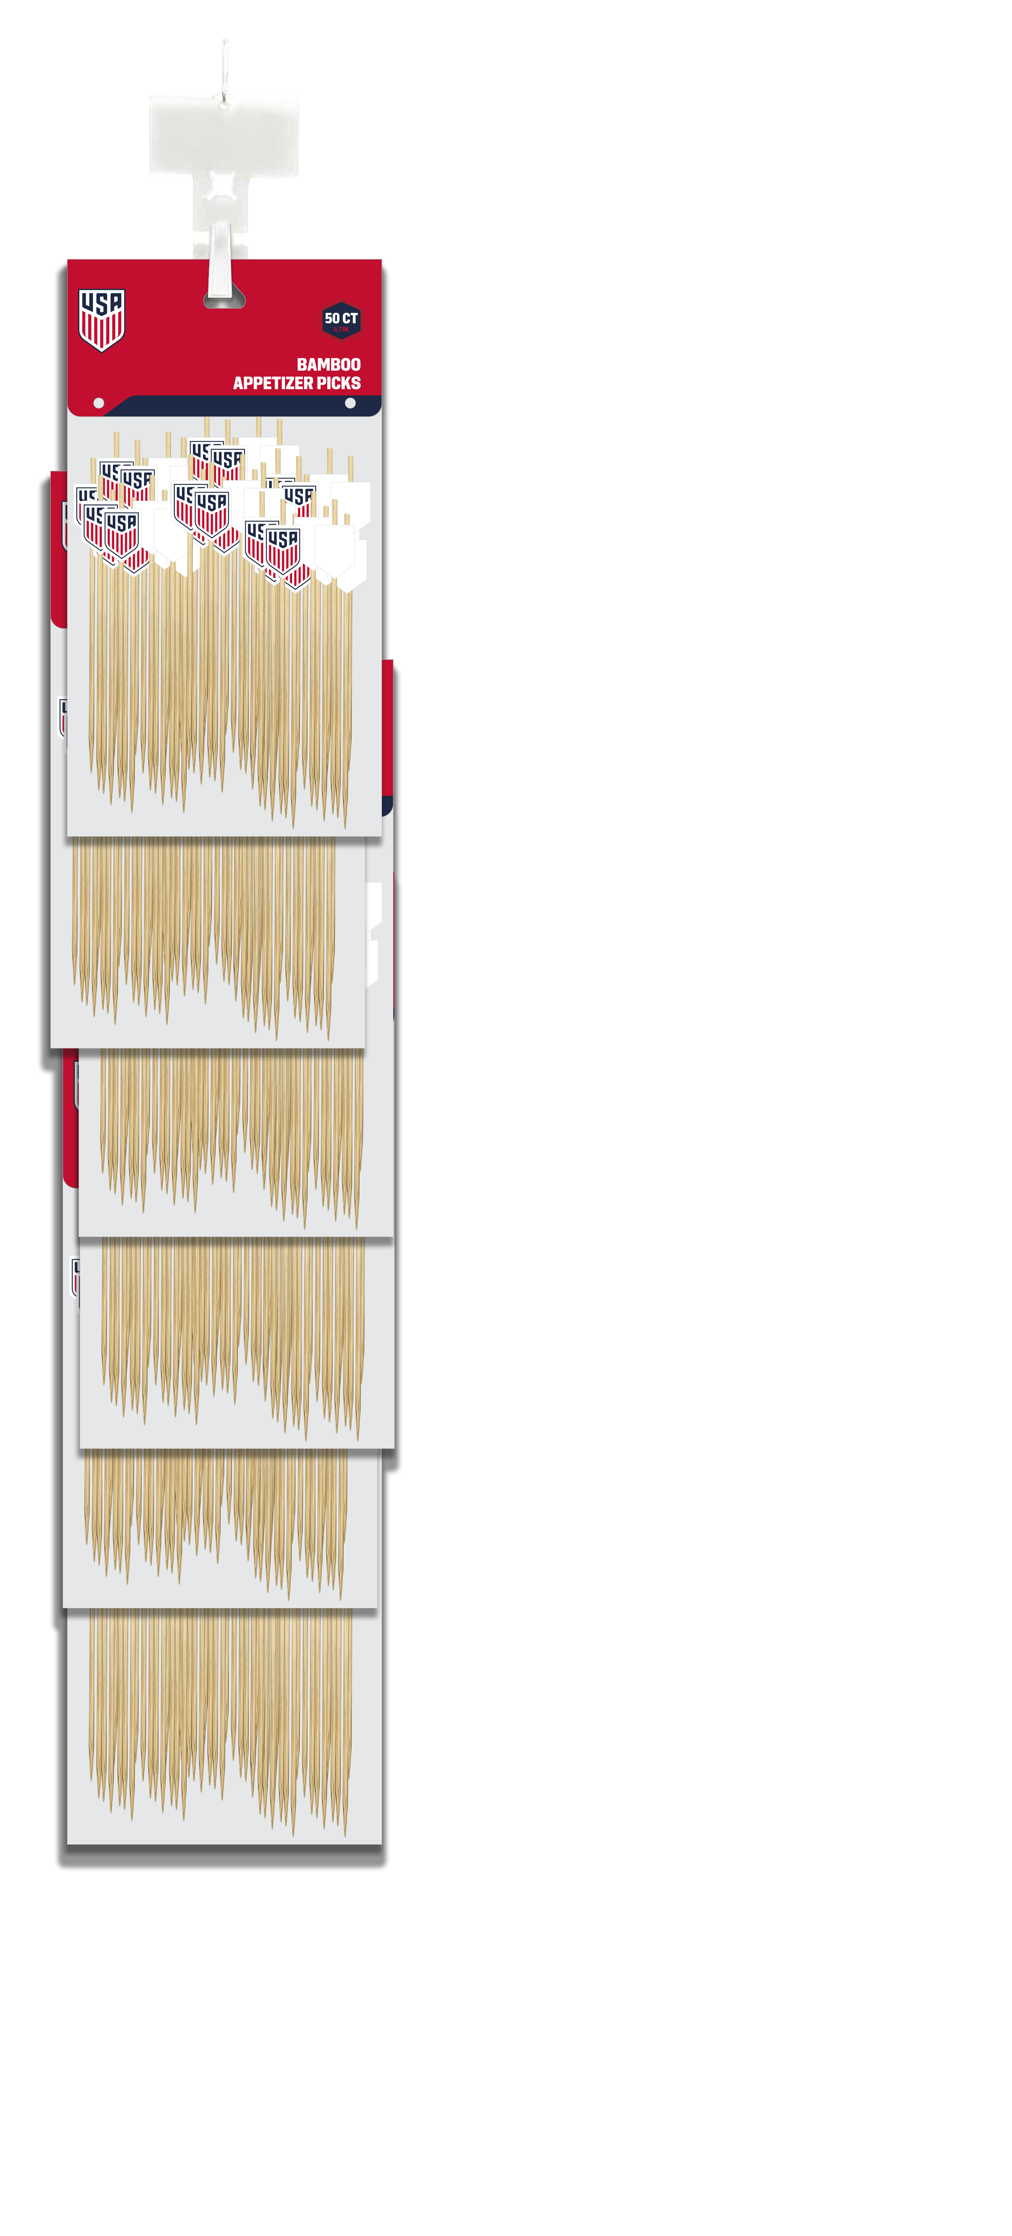
Many Display Options. Massive Sales Wins.
Flexible Placement
Mobile & versatile clip that can hang on high-impact spots, making it the perfect complement and tie-in to all U.S. Soccer in-store displays
FLEXCLIP
Scalable Order Options
Commit to as many units as needed for maximum merchandising impact
Multiple Styles & Locations
Select from a variety of flex clip styles and merchandise them on all displays to maximize visibility, impact & basket building

Slide 11
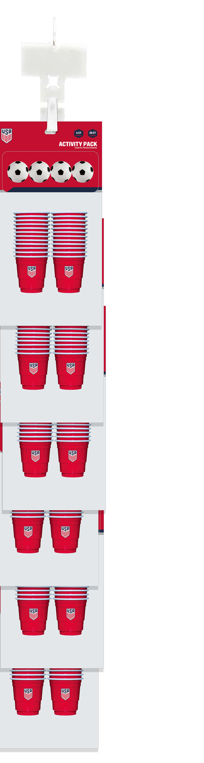
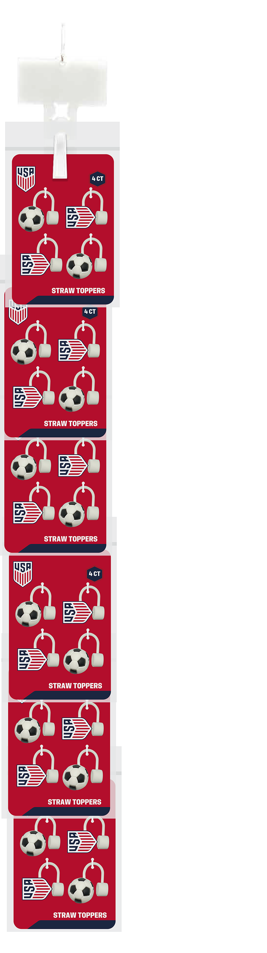
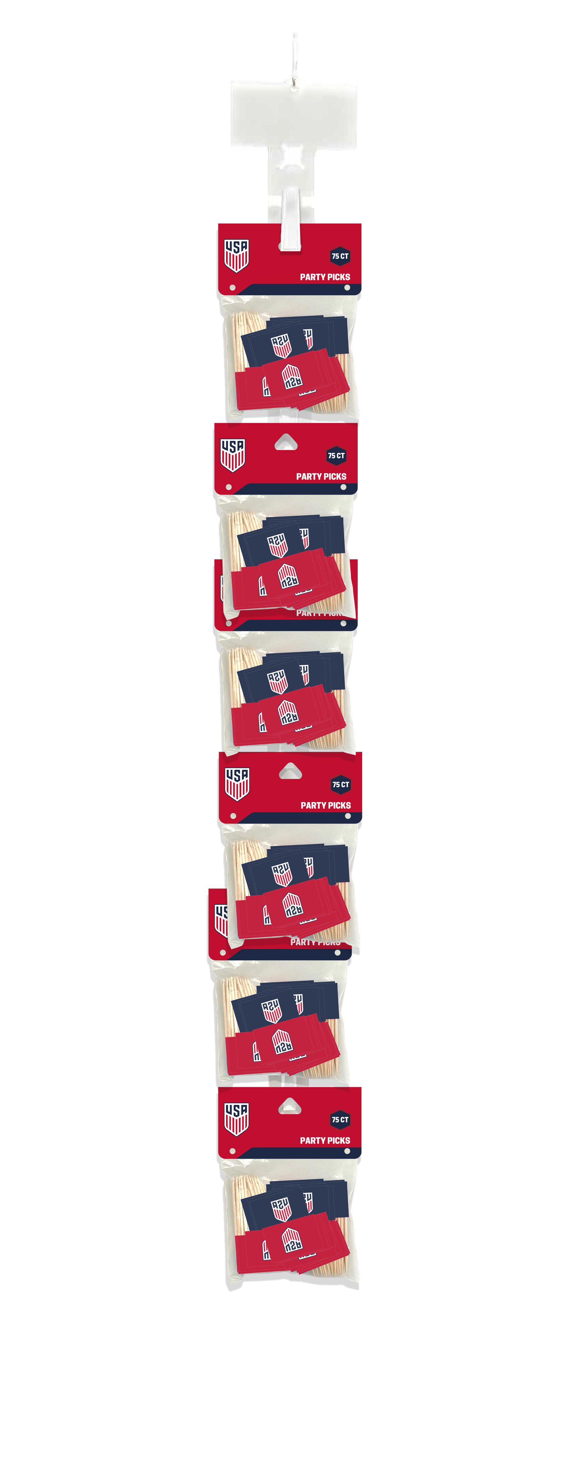

Slide 12
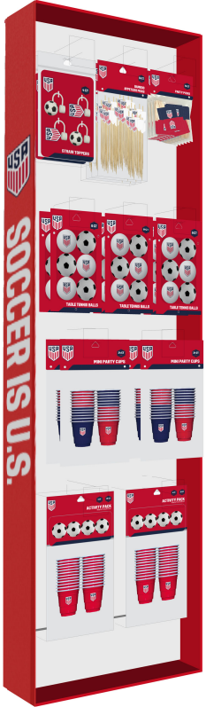
Many Display Options. Massive Sales Wins.
FLOOR DISPLAY
Feature in the “Fan Zone”
Display alongside US Soccer feature tables, displays or racks for instant relevance and basket building
Pair with Game Day Essentials
Place right by salty snacks, soda pop or beer for easy pick me ups
Eye-level access & easy grab-and-go formats encourage unplanned buys
Cohesive Branding
Official U.S. Soccer graphics ensure the display integrates seamlessly into the surrounding feature, creating a unified shopper experience

Slide 13
Many Display Options. Massive Sales Wins.
POWER PANEL
Maximizes Existing Fixtures
Jacent power panel or new panel space to create a cohesive , high-impact display in high-traffic locations
Boost Sales Velocity
Replace core items with U.S. Soccer products during the World Cup to tap into fan excitement, driving faster product turn

Slide 14
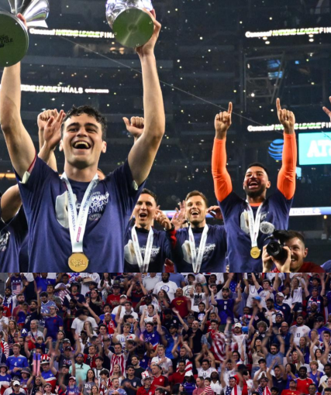

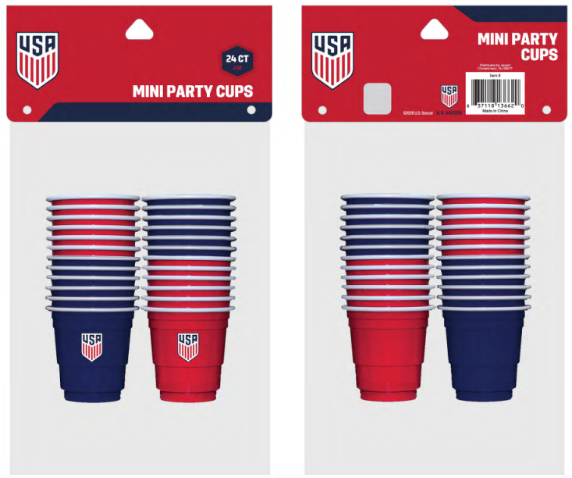

NEW
Mini Party Cups
SRP $4.99
Placement
Seasonal Flex Clip
Floor Display
Measures
Depth 1.97”
Height 8.07”
Width 5.51”
Identifier
UPC 6-37118-13662-0
Item Number 71763
Scheduled Launch
Q2 2026
US SOCCER 2026
Confidential and Proprietary Information

Slide 15
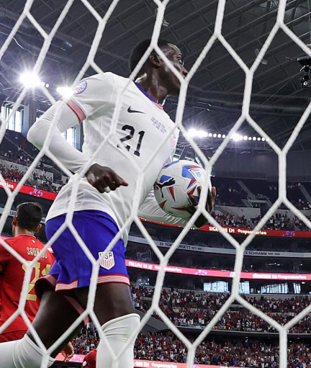
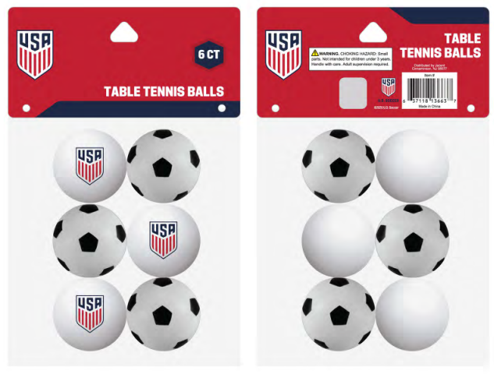
NEW
Table Tennis Balls
SRP $4.99
Placement
Seasonal Flex Clip
Floor Display
Measures
Depth 1.65”
Height 8.07”
Width 1.57”
Identifier
UPC 6-37118-13663-7
Item Number 71762
Scheduled Launch
Q2 2026
US SOCCER 2026
Confidential and Proprietary Information

Slide 16
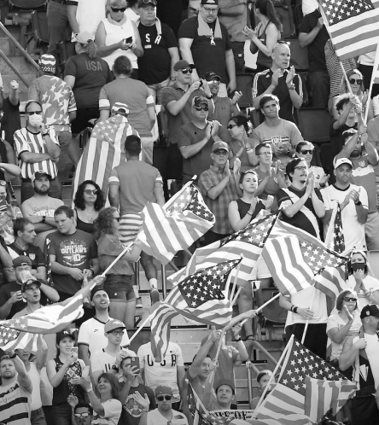
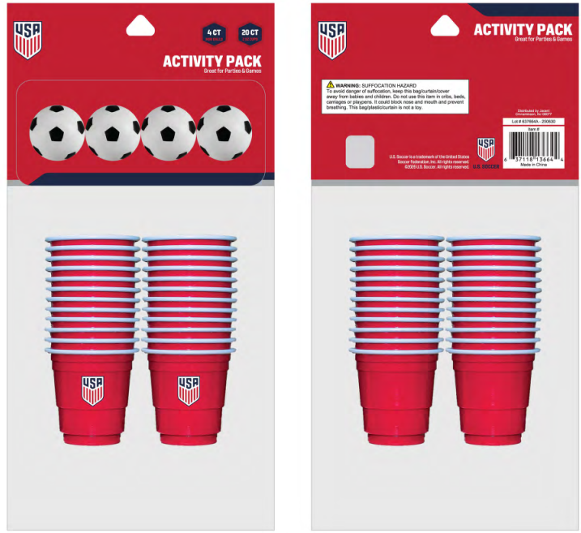
NEW
Activity Pack
SRP $4.99
Placement
Seasonal Flex Clip
Floor Display
Measures
Depth 2”
Height 9.84”
Width 5.43”
Identifier
UPC 6-37118-13664-4
Item Number 71764
Scheduled Launch
Q2 2026
US SOCCER 2026
Confidential and Proprietary Information

Slide 17
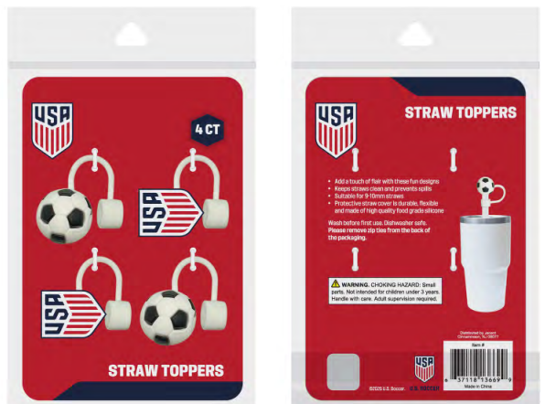
NEW
Straw Toppers
SRP $6.99
Placement
Seasonal Flex Clip
Floor Display
Measures
Depth .39”
Height 9.33”
Width 4.53”
Identifier
UPC 6-37118-13669-9
Item Number 71761
Scheduled Launch
Q2 2026
US SOCCER 2026
Confidential and Proprietary Information

Slide 18
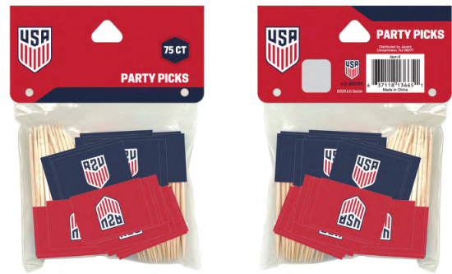
NEW
Party Picks
SRP $4.99
Placement
Seasonal Flex Clip
Floor Display
Measures
Depth .39”
Height 4.92”
Width 3.93”
Identifier
UPC 6-37118-13665-1
Item Number 71766
Scheduled Launch
Q2 2026
US SOCCER 2026
Confidential and Proprietary Information

Slide 19
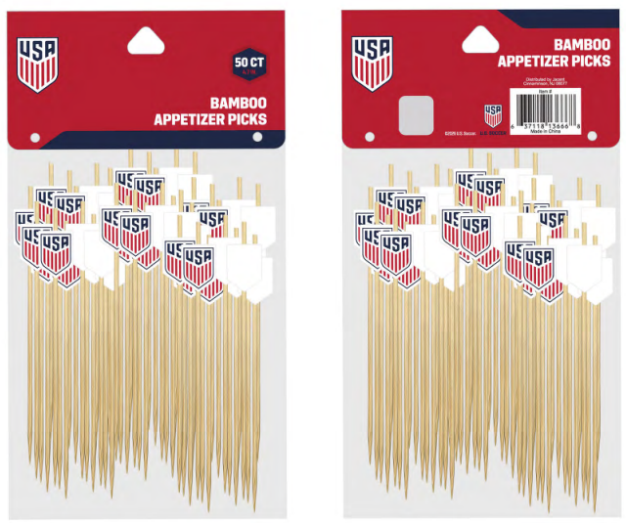

NEW
Bamboo Picks
SRP $4.99
Placement
Seasonal Flex Clip
Floor Display
Measures
Depth .79”
Height 8.27”
Width 4.33”
Identifier
UPC 6-37118-13666-8
Item Number 71759
Scheduled Launch
Q2 2026
US SOCCER 2026
Confidential and Proprietary Information

